Slide 1
ANN - Part3

Slide 2
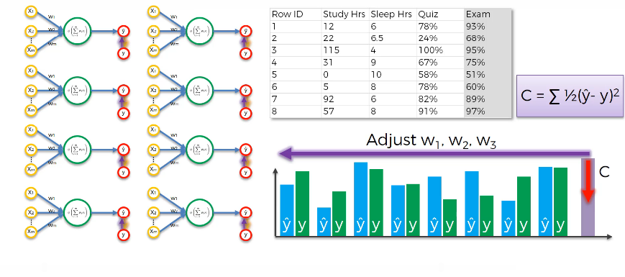
ANN – Gradient Descent

Slide 3
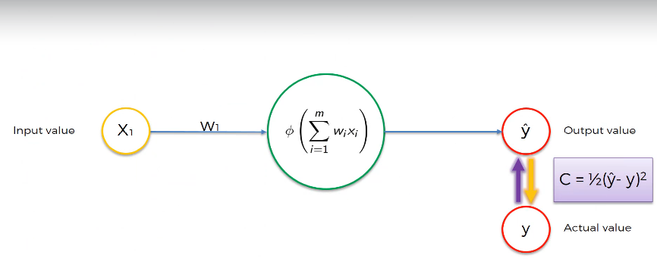
ANN – Gradient Descent

Slide 4
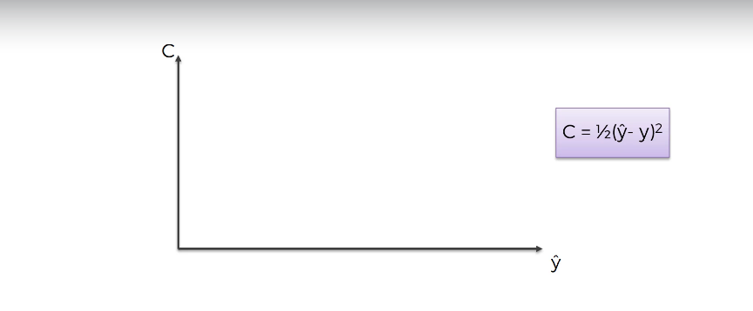
ANN – Gradient Descent
We can apply Brute Force Approach

Slide 5
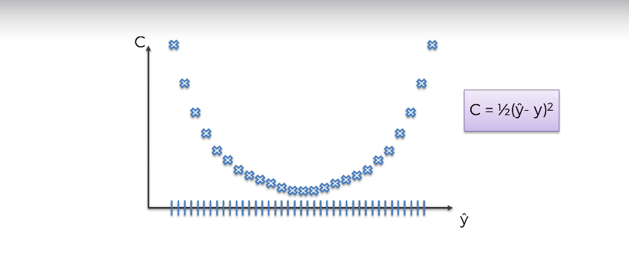
ANN – Gradient Descent

Slide 6
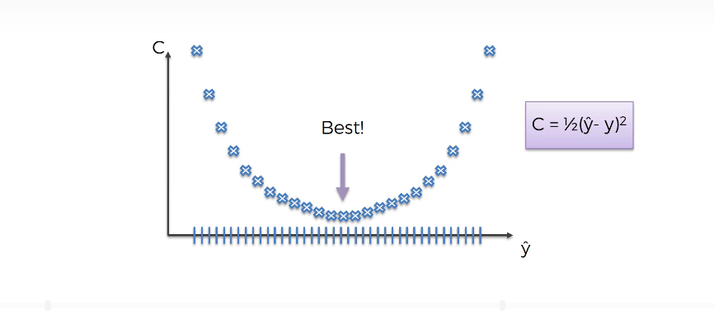
ANN – Gradient Descent
Brute Force Approach is not the best approach, since it can work best for single weight, but think of multiple weight.

Slide 7
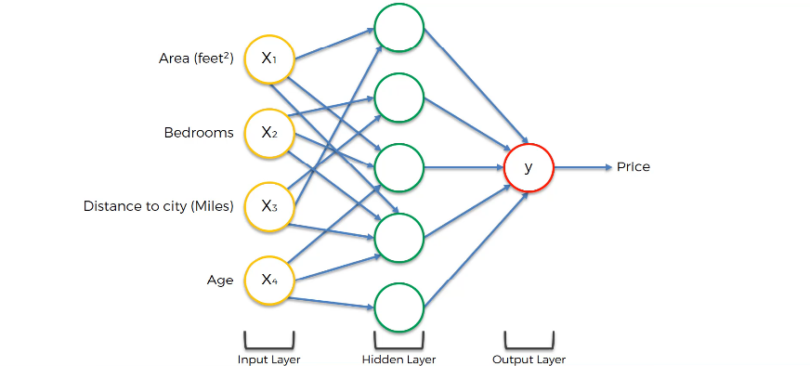
ANN – Gradient Descent

Slide 8
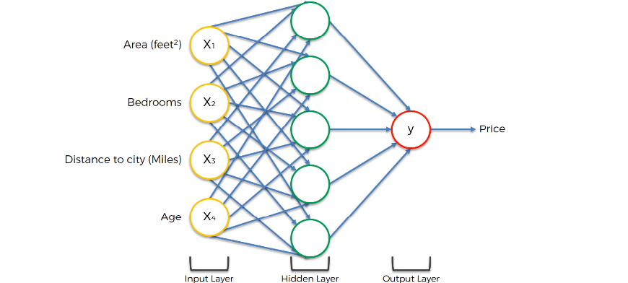
ANN – Gradient Descent
Before the weight was finalized, the Neural Net looked like this.

Slide 9
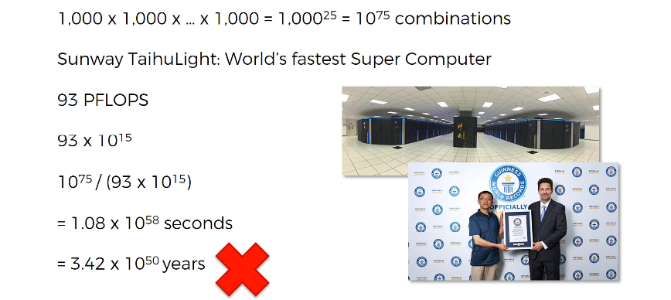
ANN – Gradient Descent

Slide 10
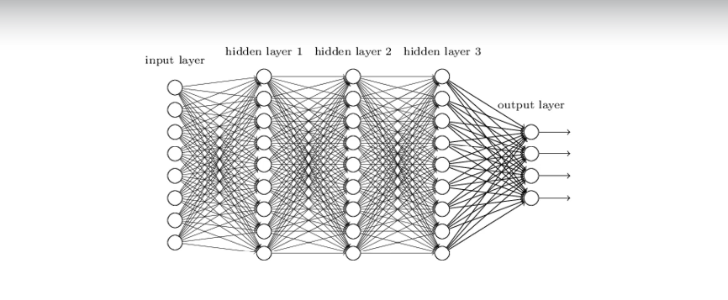
ANN – Gradient Descent

Slide 11
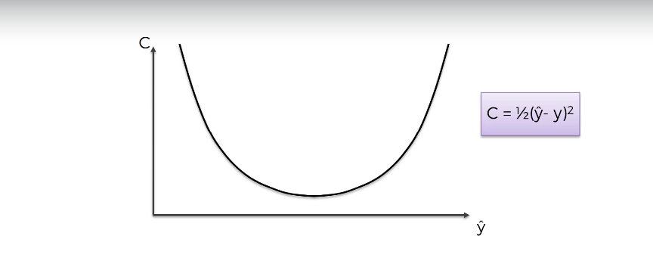
ANN – Gradient Descent

Slide 12
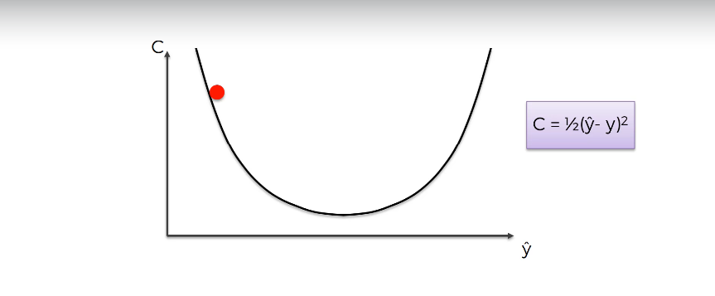
ANN – Gradient Descent

Slide 13
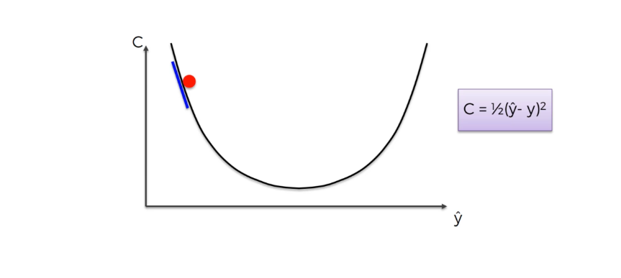
ANN – Gradient Descent

Slide 14
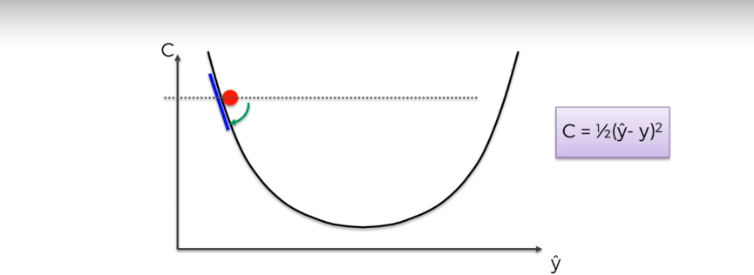
ANN – Gradient Descent

Slide 15
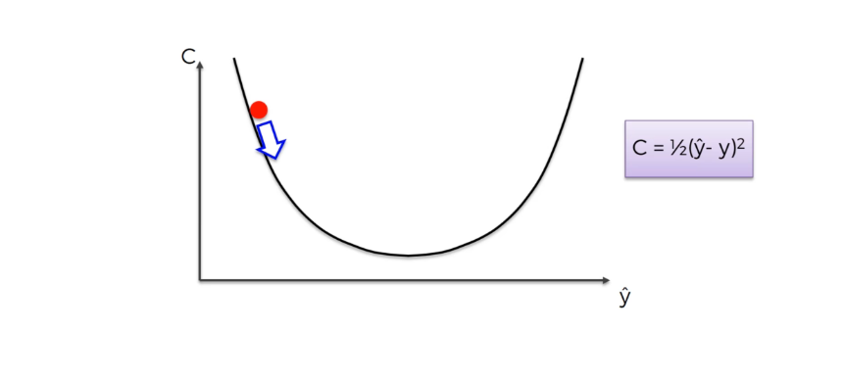
ANN – Gradient Descent

Slide 16
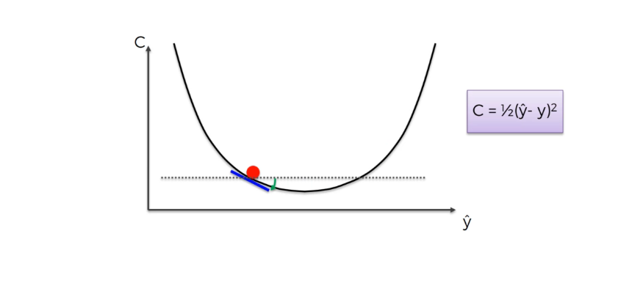
ANN – Gradient Descent

Slide 17
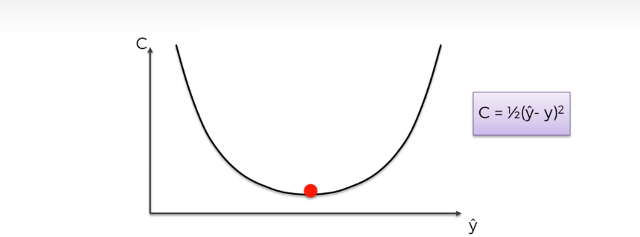
ANN – Gradient Descent

Slide 18
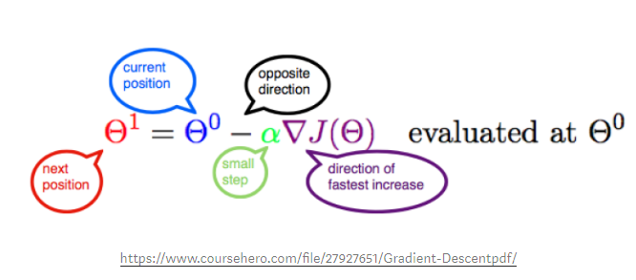
ANN – Gradient Descent
Gradient Descent Formula :

Slide 19
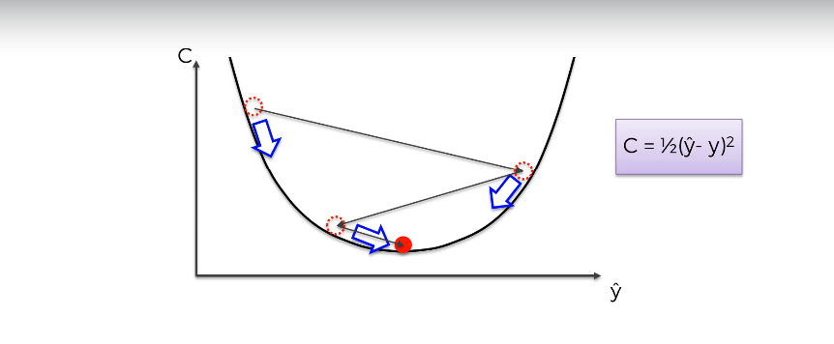
ANN – Stochastic Gradient Descent
A cost function is creating a Convex Graph

Slide 20
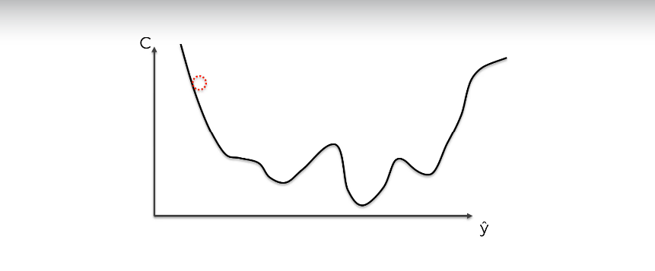
ANN – Stochastic Gradient Descent

Slide 21
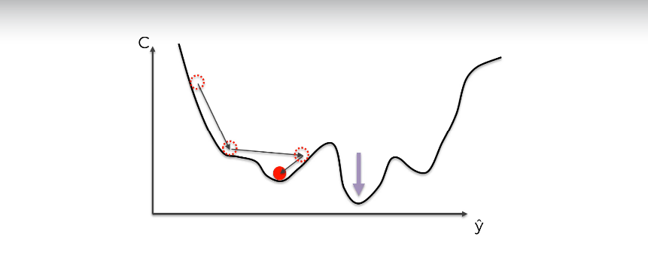
ANN – Stochastic Gradient Descent

Slide 22
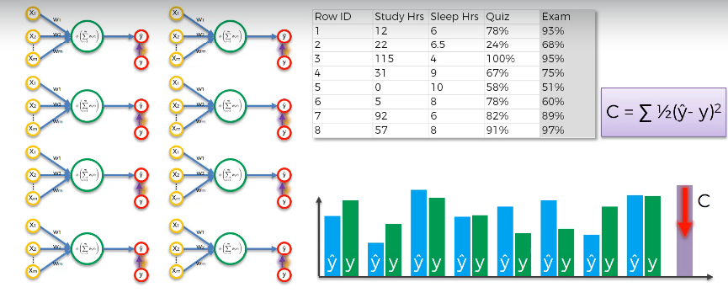
ANN – Stochastic Gradient Descent

Slide 23
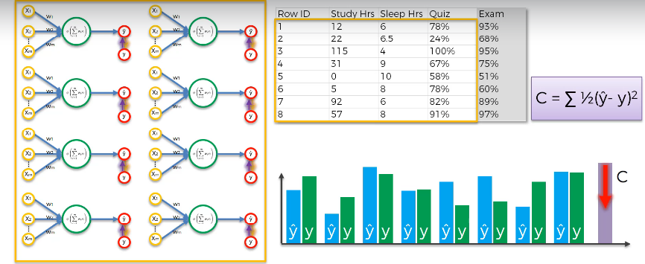
ANN – Stochastic Gradient Descent

Slide 24
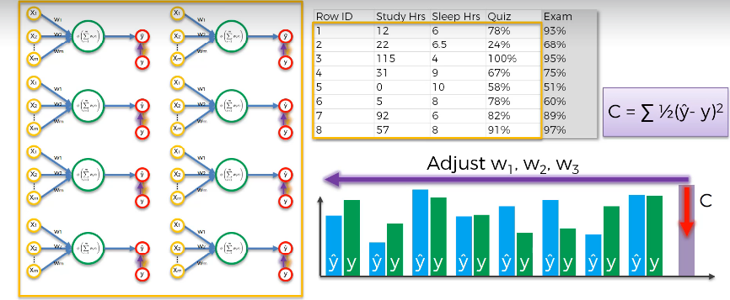
ANN – Stochastic Gradient Descent
When we adjust the weight after running all my data is known as BATCH Gradient Descent.

Slide 25
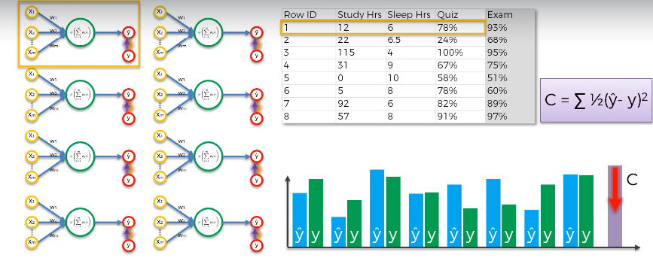
ANN – Stochastic Gradient Descent

Slide 26
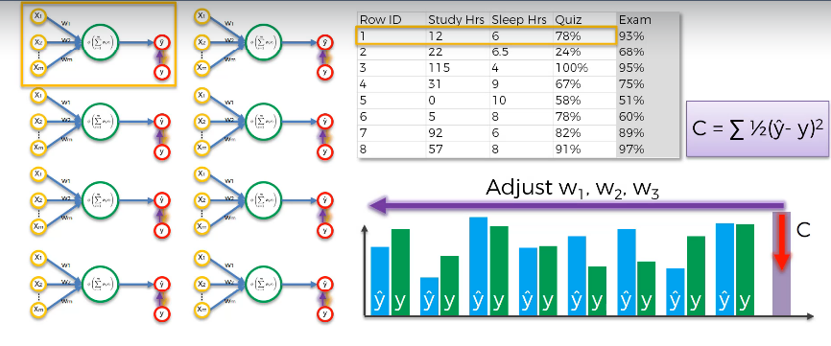
ANN – Stochastic Gradient Descent

Slide 27
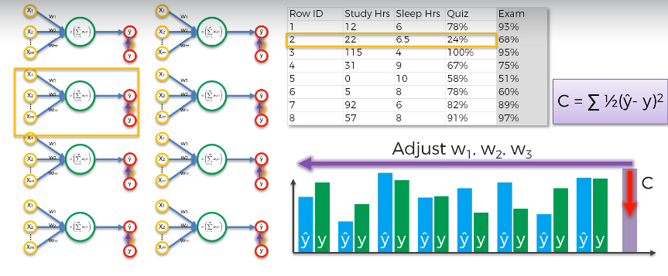
ANN – Stochastic Gradient Descent

Slide 28

ANN – Stochastic Gradient Descent

Slide 29
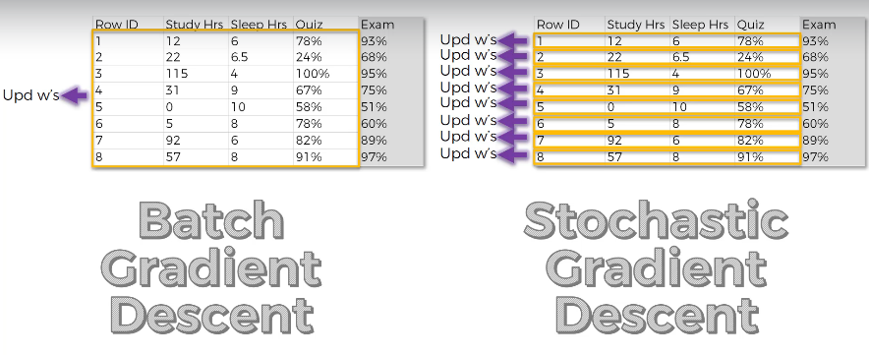
ANN – Stochastic Gradient Descent

Slide 30
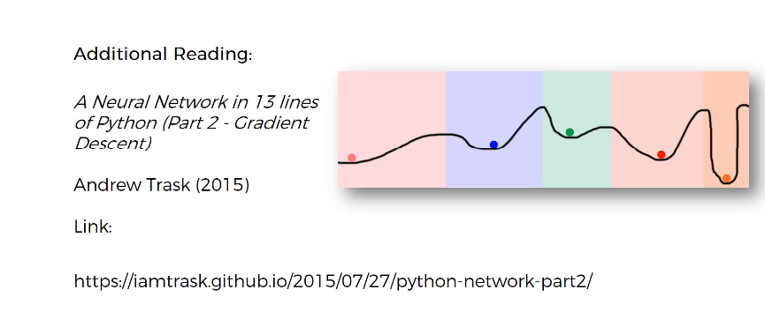
ANN – Stochastic Gradient Descent

Slide 31
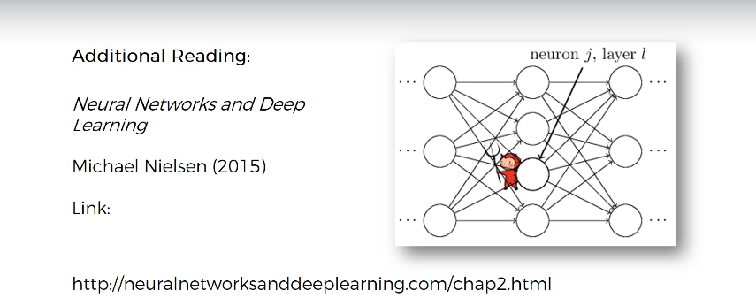
ANN – Stochastic Gradient Descent

Slide 32
ANN – Forward Propagation & ANN Back Propagation

Slide 33
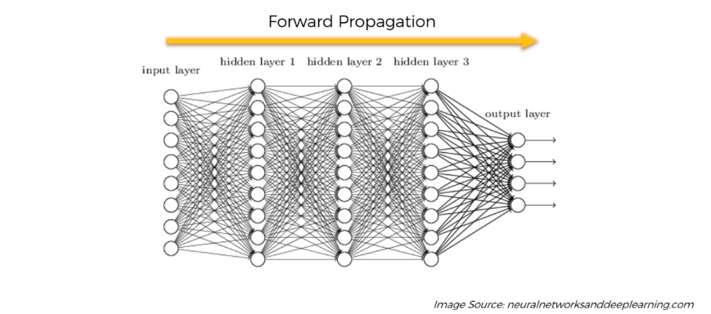
ANN – Forward Propagation

Slide 34
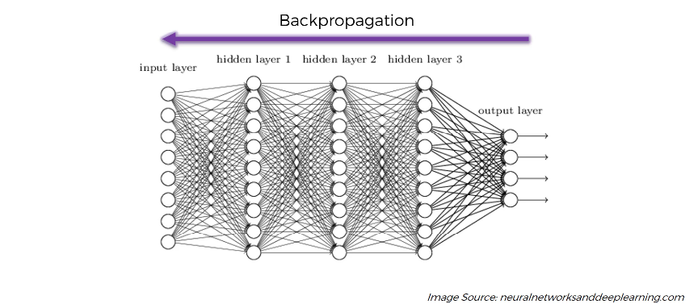
ANN – Back Propagation

Slide 35
Training ANN with Stochastic Gradient Descent

Slide 36
Training ANN with Stochastic Gradient Descent

Slide 37
Training ANN with Stochastic Gradient Descent

Slide 38
Training ANN with Stochastic Gradient Descent

Slide 39
Training ANN with Stochastic Gradient Descent

Slide 40
Training ANN with Stochastic Gradient Descent

Slide 41
Training ANN with Stochastic Gradient Descent

Slide 42
Training ANN with Stochastic Gradient Descent

